Slide 1





JavaScript Applications
Course Overview
Apps
JavaScript Applications
SoftUni Team
Technical Trainers
Software University
http://softuni.bg

Slide 2


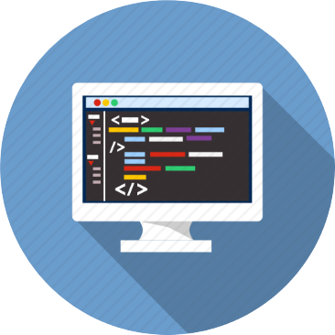
Table of Contents
Course Objectives
Course Program
Trainers Team
Course Schedule
Exams and Evaluation
Learning Resources

Slide 3
Have a Question?
sli.do #JSAPPS

Slide 4

JS Core Module @ SoftUni
JavaScript Core
Intensive 4 Months JavaScript Training

Slide 5
JS Core Module Goals
4 months intensive JavaScript development training
4 times weekly, lots of live coding, homework and projects
Part I – JS Fundamentals
JS programming, functions, arrays, strings, objects, JSON, …
Part II – JS Advanced
jQuery, DOM, object composition, classes, modules, unit testing
Part III – JS Apps
REST, AJAX, promises, templating, routing, building SPA

Slide 6
JS Core Module at SoftUni – Timeline
22-May-2017
19-Jun-2017
24-Jul-2017
20-Aug-2016
4-Sep-2017
JavaScript
Fundamentals
Lessons + exercises + workshop + exam
4 weeks * 4 times / week
9 credits
Start: 22-May-2017
Final exam: 18-Jun-2017
JavaScript Advanced
Lessons + exercises + exam
5 weeks * 4 times / week
9 credits
Start: 19-Jun-2017
Final exam: 23-Jul-2017
JavaScript Applications
Lessons + exercises + exam
4 weeks * 4 times / week
9 credits
Start: 24-Jul-2017
Final exam: 20-Aug-2017
Summer Break
2 weeks
Re-Take Exams
3 exams
3-Sept
5-Sept
7-Sept

Slide 7
Professions @ SoftUni
Java
Fund.
Java
DB
Java
Web
Programming Basics
C#
Fund.
C#
DB
C#
Web
Tech Module
JS Core Module
JS
Web
Web
Basics
PHP
Fund.
PHP
Web
Web
Basics
https://softuni.bg/curriculum
https://softuni.bg/trainings/courses

Slide 8

JavaScript Applications
Apps
Course Objectives & Program

Slide 9

Course Objectives
The JavaScript Applications course provides
Technologies for creating Single Page Apps (SPA)
Consuming RESTful Services (REST) with AJAX
Creating UI templates
Common JS programming patterns and routing

Slide 10
Course Topics
HTTP, REST Services, Postman
AJAX and jQuery AJAX
Asynchronous programming and promises
Creating single-page app with jQuery, AJAX, REST and Firebase
Templating: creating UI with Handlebars
Routing with Sammy.js
JS tools and libraries

Slide 11
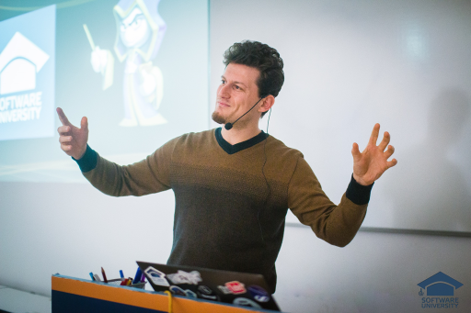
The Trainers Team

Slide 12
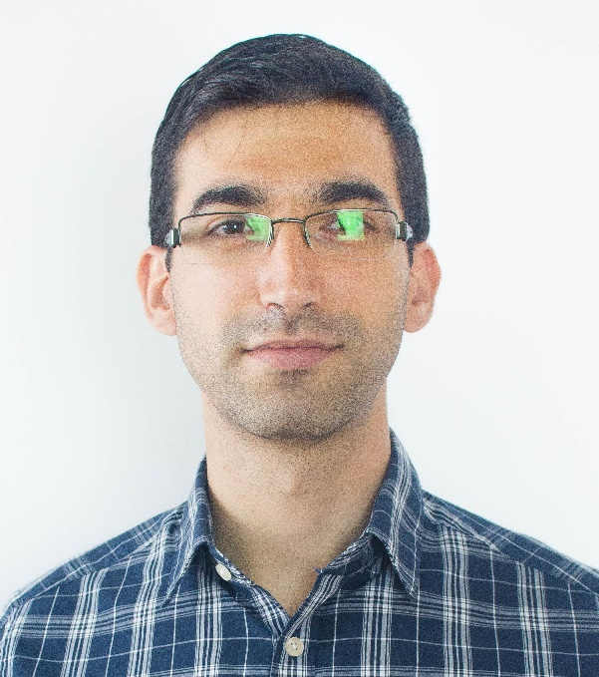
Trainers Team
Viktor Kostadinov
Technical Trainer @ Software University
Programmed as a hobby since high school
Developed a resource-sharing website during his university years
Top performing student from the Software University
Interests include astronomy and game development

Slide 13
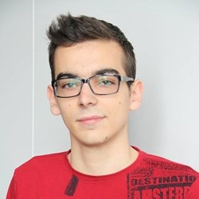
Trainers Team (3)
Kiril Kirilov
Assistant Trainer @ Software University
Involved with programming since 11th grade
Mostly interested in web development with ASP.NET
Currently studying Math & Informatics at the University of Sofia

Slide 14
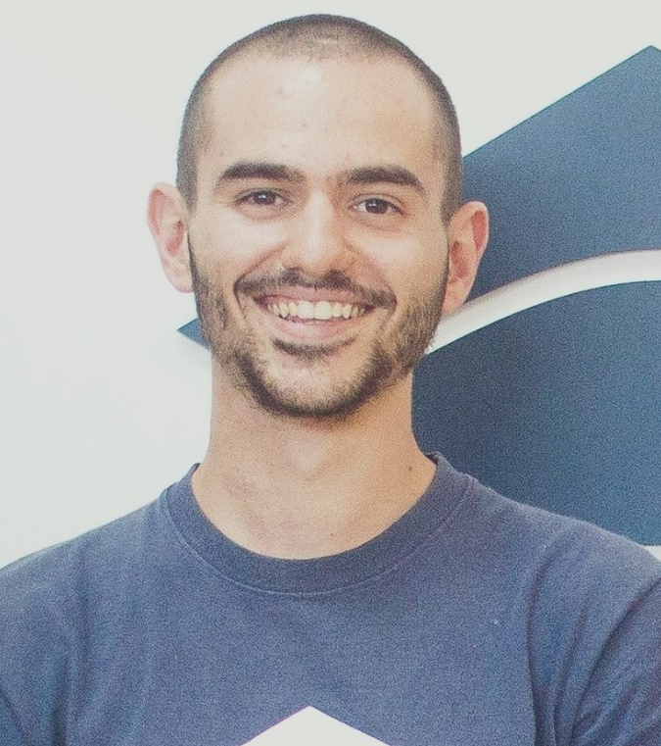
Trainers Team (4)
Bozhidar Gevechanov
Technical Trainer @ Software University
Top performing student from the Software University
Experience in developing mobile games with Unity3D

Slide 15
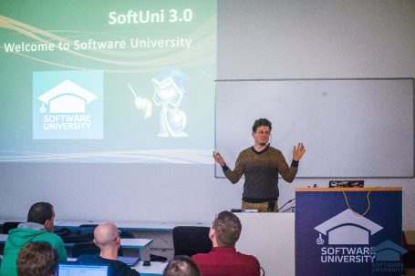


JavaScript Applications
Course Details and Schedule

Slide 16
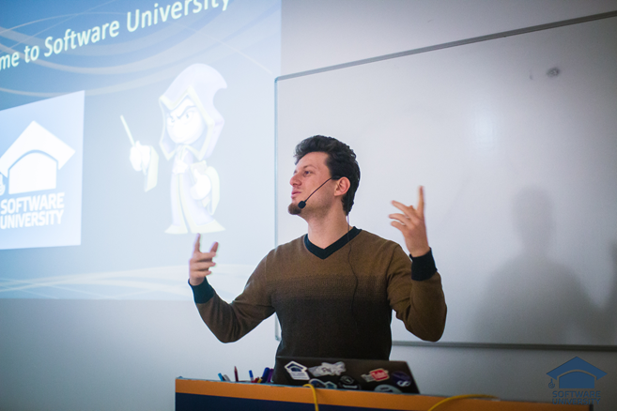
Training Duration and Schedule
Lessons: ~ 15-20 hours (onsite + YouTube videos)
Practical exercises (in class): ~ 30-40 hours
Homework: ~ 0-40 hours
Time frame
July – Aug 2017
Exam: 20-Aug-2017

Slide 17


Why English?
Why the slides are in English?
English is the native language of the software engineers
Specific terminology should be in English
Translations are inaccurate and funny
Just learn English!
No excuses

Slide 18

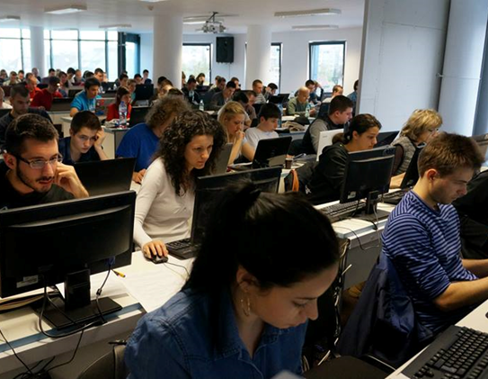
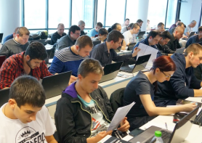
JavaScript Applications
Evaluation Criteria

Slide 19
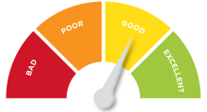

Scoring System for the Course
Mandatory:
Final exam – 85%
Homework submissions – 15%
Bonuses:
Presence in class – 5% bonus
Forum activity – bonus up to 5%

Slide 20

The Final Exam
Create a SPA (single page app)
Implement CRUD operations + login / register / logout
Use AJAX and REST + cloud-based back-end (Kinvey)
Optionally:
Use templates for rendering
Use MVC architecture + routing
AJAX
REST
Kinvey

Slide 21


Homework Assignments
Your homework is mainly work in class!
Lesson days → slides + live demos + exercises
Exercise days → only exercises
How to submit your homework?
Some submitted in the judge system
Others uploaded in the course Web site
Homework assignments are due in 7 days

Slide 22










Resources
What We Need Additionally?

Slide 23



Course Web Site, Forum and FB Group
Official web site:
Official discussion forum:
Official Facebook group:
softuni.bg/courses/javascript-applications
softuni.bg/forum/categories/20
fb.com/groups/292674664491806/

Slide 24

The Programming Basics Slides and Videos
All lecture slides, videos, homework assignments, projects and other resources are open content, available for free
Visit the course web site to access the course resources

Slide 25



Recommended Software
Software needed for this course:
Noje.js – https://nodejs.org
WebStorm – https://jetbrains.com/webstorm/
Optionally:
Visual Studio Code – https://code.visualstudio.com

Slide 26







JavaScript Applications – Course Overview
https://softuni.bg/courses/

Slide 27
License
This course (slides, examples, demos, videos, homework, etc.) is licensed under the "Creative Commons Attribution-NonCommercial-ShareAlike 4.0 International" license

Slide 28





Free Trainings @ Software University
Software University Foundation – softuni.org
Software University – High-Quality Education, Profession and Job for Software Developers
softuni.bg
Software University @ Facebook
facebook.com/SoftwareUniversity
Software University Forums
forum.softuni.bg

